Slide 1
Developer Experience at Abbott
Developer Experience and tooling

Slide 2
Executive Summary
Developer Experience and tooling
Abbott is adopting an increasing AI-native approach to software delivery, embedding AI across the full software lifecycle to support product, engineering, quality, security, and operations. Automation of routine work and by connecting planning, build, test, release, and compliance through shared context, this model enables faster delivery, higher quality, and stronger governance. Enabling teams to focus on solving meaningful problems using the best tools possible.
Key priorities include:
Enabling end-to-end software delivery with AI embedded across planning, building, testing, releasing, and operations.
Standardizing enterprise patterns and guardrails for onboarding, governing, and scaling AI capabilities safely and consistently.
Driving adoption of enterprise-approved tools while evaluating emerging solutions through structured Assess and Trial processes.
Balancing automation with human judgment to ensure accuracy, ethics, and strategic alignment.
This shift positions Abbott to deliver high-quality, compliant, and enterprise-grade software faster and more predictably—using AI as a foundational capability for modern software delivery.

Slide 3
Software Delivery at Abbott
Developer Experience and tooling
An AI-native approach to building, testing, releasing, and operating software with shared context and automation across all roles.
Planning & Requirements
Build & Implement
Releasing & Operations
Security & Compliance
Testing & Quality
Product / Architecture / Quality
AI helps turn ideas and documents into clear, traceable requirements. Enabled by: Jira · Confluence · ALM · ChatGPT Enterprise*
Engineering / Security
AI assists with code creation, explanation, and test scaffolding. Enabled by: GitHub / GitHub Copilot / jFrog / Claude Code*
Engineering / Operations
Automated pipelines and AI insights improve reliability and recovery. Enabled by: GitHub Actions / New Relic / Open Telemetry
Quality / Security / Regulatory
Continuous scanning and evidence generation reduce risk and audit effort.
Enabled by: GitHub Advanced Security
Quality / Engineering
Automated and AI-assisted testing improves coverage and catches issues earlier.
Enabled by: Browser Stack / Tosca / Selenium
AI – Native Platform Foundation (ChatGPT Enterprise / Claude Enterprise*) A shared, enterprise-approved AI platform that spans the full software lifecycle. Provides secure access to frontier models, shared context, reusable prompts, and agent capabilities that integrate across planning, coding, testing, release, and operations.
Legend: Bold = AI-enabled capability, * = Agreement in progress (MSA / SOW)

Slide 4
Software Delivery
Developer Experience and tooling
Current Enterprise Tools in production
Tool / Platform | Primary Usage | Cost Model | Support & Ownership | How to request Access
GitHub | Source control, collaboration, code management | $360/User/Year | Managed service (DTS) | IIQ Request
GitHub Actions | CI/CD automation, build and release pipelines | Included in base GitHub cost | Managed service (DTS) | IIQ Request
GitHub Advanced Security | Code scanning, dependency, secret detection | $600/User/Year | Managed service (DTS) | Service Now Request
Jira | Planning, work tracking, workflow management | $200/User/Year | Managed service (DTS) | Service Now Request
Confluence | Documentation, knowledge management | $200/User/Year | Managed service (DTS) | Service Now Request
ALM | Traceability, lifecycle governance, regulated delivery | $300/User/Year Concurrent users | Managed service (DTS) | ESAM Request
BrowserStack | Cross-browser and device testing | Usage-based | Managed service (DTS) | IIQ Request
Tosca | Automated functional and regression testing | $7000/User/year Concurrent users | Managed service (DTS) | IIQ Request
Selenium | Test automation framework | Open source | Team-managed (within standards) | Open Source team managed

Slide 5
Divisional Usage of BTS Tools
Developer Experience and tooling
Abbott Enterprise GitHub
Abbott Enterprise Atlassian
Division | GitHub Users | Copilot Users
ADC | 262 | 182
ADD | 368 | 203
AN | 174 | 46
ARDx | 189 | 112
AV | 44 | 23
EPD | 55 | 40
Lingo | 158 | 49
MD | 350 | 320
BTS | 600 | 300
Total | 2200 | 1275
Division | Jira/Confluence Users
ADC | 100
ADD | 250
AN | 38
ARDx | 50
AV | 20
EPD | 30
Lingo | 170
MD | 600
BTS | 2100
Total | 3358*
This is the usage of the BTS managed enterprise instances of GitHub and Atlassian. *There are other~75 other Atlassian instances at Abbott. E.g., ADC operates their own self managed instance for ~2,000 users, ungoverned or managed by BTS This is the only GitHub instance at Abbott

Slide 6
AI Software Delivery
Developer Experience and tooling
2026 Tools Roadmap (AI-Native Expansion)
Tool / Platform | Planned Usage | Primary Roles | Cost Model (Planned) | Support Approach
ChatGPT Enterprise | Requirements drafting, documentation, analysis, shared AI context across lifecycle | Product, Engineering, Quality, Ops | Consumption base costs | Support with ADC Pilot, Build BTS Instance for expansion
Claude (Enterprise / Code) | Code generation, explanation, review, and test scaffolding | Product, Engineering, Quality, Ops | Consumption base costs | Working on BTS enabled instance adopted by ADC POC initially.
Ketryx | AI-assisted quality, traceability, and compliance automation across regulated software lifecycles | Quality, Regulatory, Engineering | Per-user / enterprise license

Slide 7
Enablement Standards for Vendor Tools at Abbott
Developer Experience and Toolchain
Proof Of Concept/Trial
A repeatable 45-day POV/POC engagement is run to evaluate vendor capabilities against Abbott’s defined requirements.
During pilot, the platform is be validated against BTS QC09 Software Lifecycle (SLC) process.
Must complete:
DLM (Data Lifecycle Management)
DIPP (Data Integrity Protection Plan)
BIA (Business Impact Analysis) These documents ensure compliance with data security, data management, and business continuity requirements.
MSA agreements are assessed as a parallel activity lead by Procurement / Legal
Each platform/product must support:
SSO (Single Sign-On) enabled by Abbott’s Microsoft Entra ID
SCIM (Integration with Azure Entra ID)
RBAC (Role-Based Access Control)
Vendor must undergo two separate CVRM reviews:
Quality CVRM
Security CVRM
Vendor must produce certifications (ISO 27001/SOC 2/FedRAMP)

Slide 8

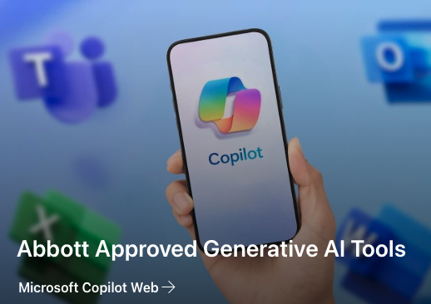
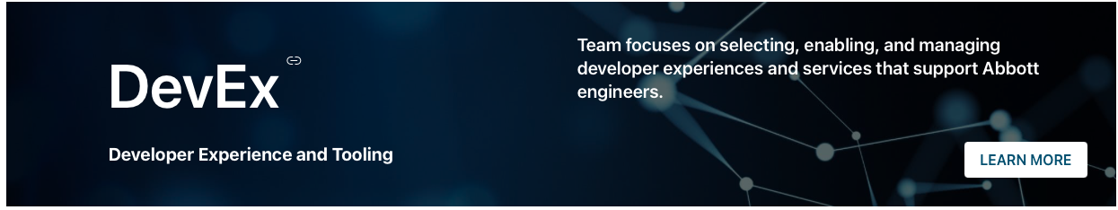
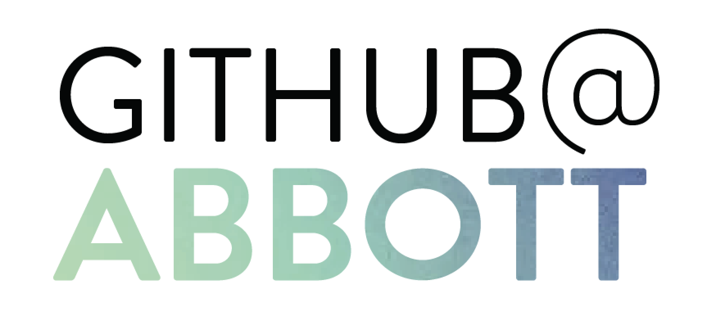
BTS Software Delivery
Developer Experience and tooling
How to stay connected and informed
GenAI Developer Companion Tools
Abbott Approved Generative AI Tools
Developer Experience and Tooling
Our GitHub@Abbott community has 1,500 active users with 17 posts and 58 replies over the last 90 days.
GitHub@Abbott | Microsoft Teams

Slide 9
Key Themes and Techniques
What is emerging beyond the tooling
Agents and Model Context Protocols (MCP)
AI agents automate complex, multi-step workflows by integrating directly with enterprise systems.
MCPs provide a secure, standardized way for AI models to access tools, APIs, and data.
Together, they enable scalable automation while maintaining governance, traceability, and enterprise control.
Shared Context and Instructions
AI systems perform best when provided with structured context, clear goals, and explicit constraints.
Standardized prompt patterns and reusable “instruction blocks” reduce variability and improve output quality
Capturing and reusing context accelerates workflows and ensures consistent outcomes across teams.
Spec-Driven Development
Starting with an AI-generated or human-authored specification reduces rework and creates clarity before coding begins
Specs guide both humans and AI coding tools, improving quality, reducing defects, and accelerating development.
This approach aligns product, engineering, and AI agents around a shared blueprint from the start.
Continued Need for Human Judgement
AI accelerates work but still requires oversight for accuracy, ethics, risk, and business alignment.
Humans remain essential for validating assumptions, making trade-offs, and interpreting ambiguous requirements
Effective human–AI collaboration maximizes productivity while ensuring outcomes remain trustworthy and strategic.

Slide 10

Code Creation and Management
Developer Experience and tooling
Platform Tools
12
A set of AI-enabled platforms that streamline software development, DevOps, and security workflows. These tools reduce manual engineering tasks, improve code quality, accelerate delivery timelines, and enhance visibility into development performance. They help teams ship software faster, safer, and with stronger governance.
11
10
Adopt
GitHub Copilot (AI pair programmer)
GitHub (Actions, Source Code Management)
jFrog Artifactory
Trial
ChatGPT Enterprise (ADC/DTS)
Claude Code (ADC/DTS)
Assess
Claude Enterprise (ADC/DTS)
CodeRabbit (ADC)
Rematiq (AI workflow automation) (ADC)
Hold
Jenkins
Sonarqube
Bitbucket
Agentic Tools
7
8
5
3
4
9
1
2
Hold
Assess
Trial
Adopt
GitHub Copilot is now widely adopted across the enterprise, with four tools actively in use by Abbott teams. ChatGPT and Claude are progressing from trial phases toward full adoption.

Slide 11
Security, Compliance, and Governance
Developer Experience and tooling
AI-powered platforms that manage regulatory intelligence, compliance operations, traceability, and documentation. They help organizations stay aligned with evolving regulations, reduce compliance risk, automate audit artifacts, and ensure that controlled processes and regulated software remain compliant over time.
8
7
5
Adopt
GitHub Advance Security
ALM
Trial
N/A
Assess
Aikido (ADC)
Regology (ADC)
Ketryx (Lingo)
Collate (DTS)
Hold
Veracode
Sonarqube
jFrog Advance Security
4
6
2
1
3
Hold
Assess
Trial
Adopt
AI-driven security and compliance tools reduce risk, automate evidence and monitoring, and help teams stay aligned with evolving regulations—strengthening protection, improving audit readiness, and ensuring trusted, compliant software delivery.

Slide 12
Monitoring and Observability
Developer Experience and tooling
Monitoring and observability tools deliver real-time insight into system and AI application performance. AI-enhanced platforms surface issues faster, automate root-cause analysis, and help teams ensure reliable, high-quality digital and LLM-driven experiences.
9
Adopt
New Relic
Sentry
OpenTelemetry
Trial
LangSmith/LangFuse
Azure AI Foundry (trace and eval)
Assess
Arize Phoenix
Ragas
Whylabs
PA-Runtime
Hold
N/A
8
7
6
5
3
2
4
1
Hold
Assess
Trial
Adopt
New Relic is existing tool that now being trialed across multiple AI projects for continued adoption across the enterprise. Lang Smith/Lang Fuse also actively used for pilot projects by Abbott teams. Many other tools are on assess to support cloud, cybersecurity needs
Notes:
NewRelic is existing tool that now being trialed across multiple AI projects for adoption across the enterprise. LangSmith/LangFuse is actively used for pilot projects by Abbott teams. doption

Slide 13
Product, Design, and Knowledge Management
Developer Experience and tooling
AI-enhanced project and knowledge management tools streamline planning, documentation, and collaboration by automating routine work and delivering real-time insights. They turn organizational knowledge into an intelligent, searchable resource and help teams stay aligned and move faster.
13
Adopt
Jira
Confluence
MS Teams
Slack
Figma
Miro
Adobe Express
Adobe Firefly
Trial
ChatGPT Enterprise
Claude Enterprise
Atlassian Rovo
Assess
Notion AI
Airtable AI
Hold
N/A
11
12
10
7
8
6
9
5
2
4
3
1
Hold
Assess
Trial
Adopt
Improve alignment, transparency, and execution by unifying project planning, documentation, and knowledge workflows into a single, AI-accelerated operational backbone for engineering teams.

Slide 14
Design, UX, and Product Ideation
Developer Experience and tooling
Generative design and creative tools accelerate UI/UX work, content creation, and visual collaboration—helping teams ideate faster, shorten design cycles, produce high-quality assets, and maintain consistent brand experiences.
Adopt
Figma
Miro
Jira Product Discovery
Adobe Express
Adobe Firefly
Trial
Miro AI
Figma AI (trial complete)
Assess
Adobe Foundry
Notion AI
Hold
N/A
9
7
8
6
1
2
5
3
4
Hold
Assess
Trial
Adopt
Miro is used for product ideation and Figma is used for UI-UX designs, and Adobe Express is being rolled out for UX for marketing artifacts. Miro AI is being trialed

Slide 15
Challenges with Enabling Tools at Abbott
Developer Experience and Toolchain
Corporate Groups can Slow progress
Processes from BTS, Legal, and Privacy can degrade the experience of tools limiting the value that they can enable at Abbott
Limited retention timelines
Blocking certain capabilities within an application (e.g. Copy & Paste), or allowing non-approved third party addons
Device management controls (data loss prevention) and mandating Abbott owned and managed devices
Enforcement of SSO, MFA that requires onboarding via FieldGlass
Complex Internal Process Slow Implementation
Need completion of CDA/IT Evaluation/MSA to do any discovery work
Any GenAI based tool needs approval from GenAI COE before any discovery work

